Slide 1
BOARD INFINITY DECODE-10.3
M.GURUPRASAD REDDY

Slide 2
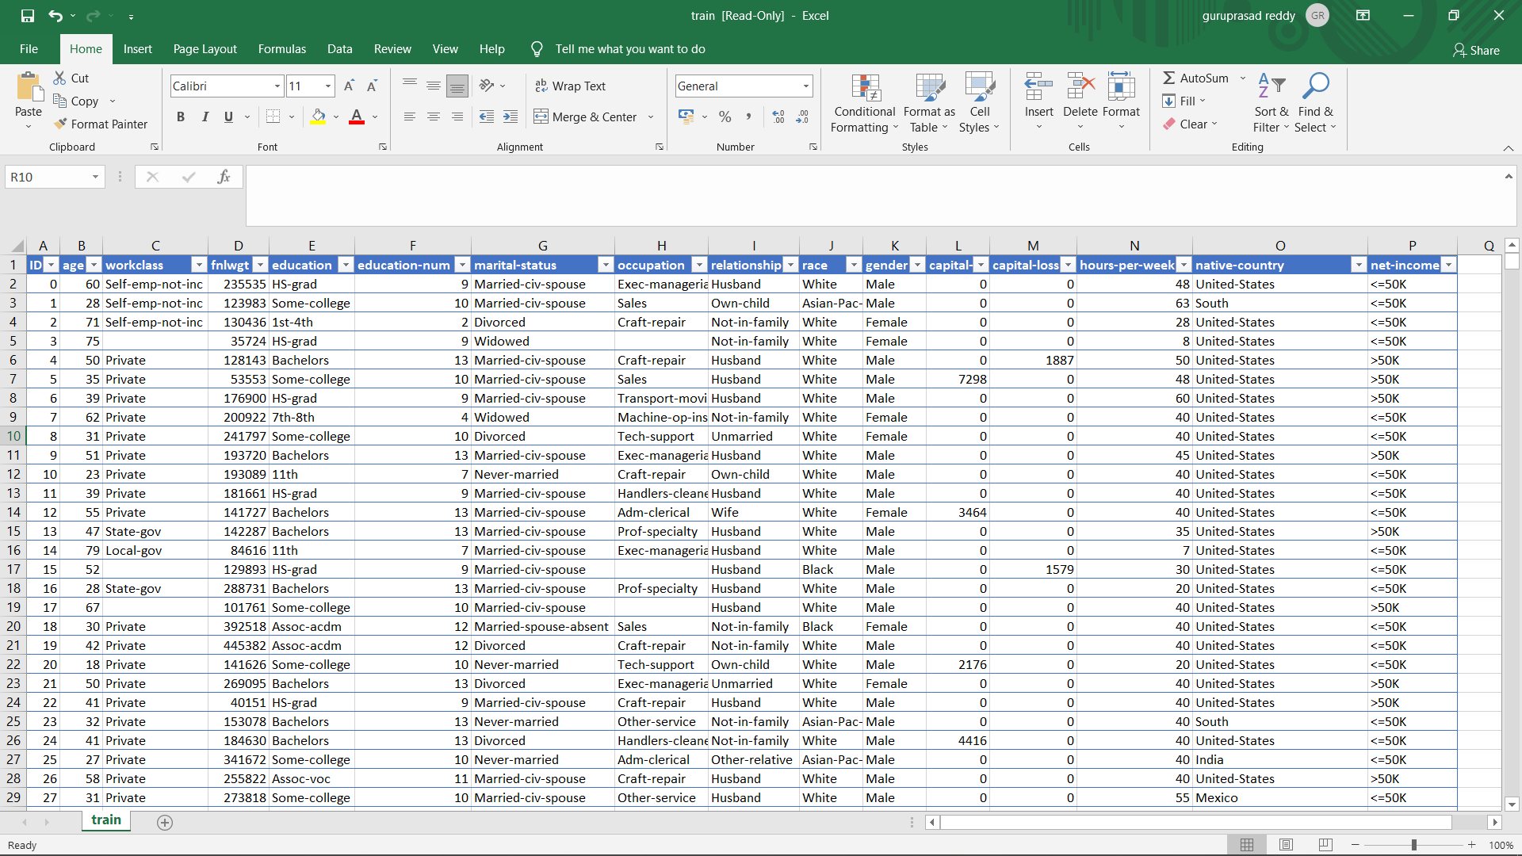
IN THIS HACKATHON I PREPARED AN INTERACTIVE DASHBOARD ON THE DATA GIVE BY THE BOARD INFINITY .
THE DATA CONTAINS 16 –FIELDS IN THAT 3 FIELDS CONTAINS NULL VALUES
THEY ARE :-
1-OCCUPATION
2-COUNTRY
3-WORKCLASS

Slide 3
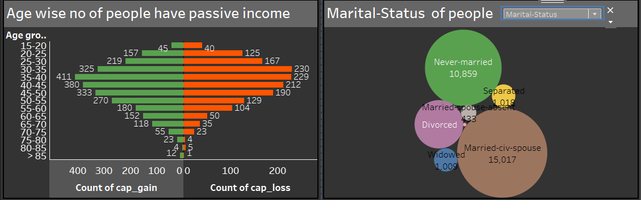
1.WHICH AGE GROUP HAVE MORE NUMBER PEOPLE HAVING PASSIVE INCOME (LOSS OR GAIN) ?
2.HOW MANY PEOPLE ARE MARRIED ?
3.WHAT IS THE SECOND MOST RACE IN US ?
4.WHAT IS THE RELATIONSHIP STATUS OF PEOPLE ?

Slide 4
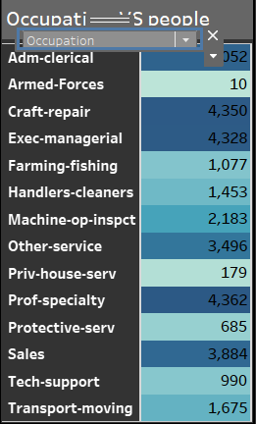

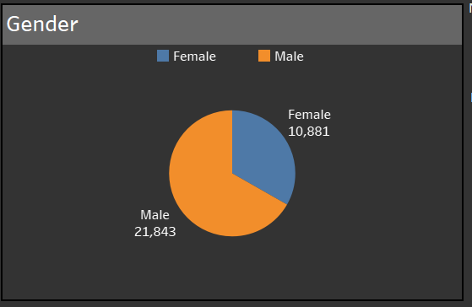
5.HOW MANY PEOPLE DOES THE DATASET CONTAINS ?
6.HOW MANY MALES AND FEMALES ARE THERE?
7.HOW MANY PEOPLE ARE THERE WHOSE OCUPATION IS FARMING AND FISHING ?
8.IN WHICH SECTOR MORE NUMBER OF PEOPLE WORKING IN ?
9.HOW MANY PEOPLE IN US STUDIED ONLY UPTO 10th ?
10 .WHAT IS THE TOTAL POPULATION THAT THE DATA CAN REPRESENT (APPROX) ?

Slide 5
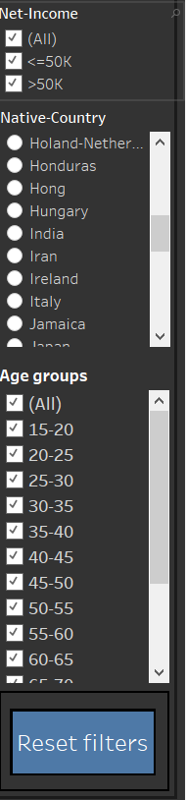
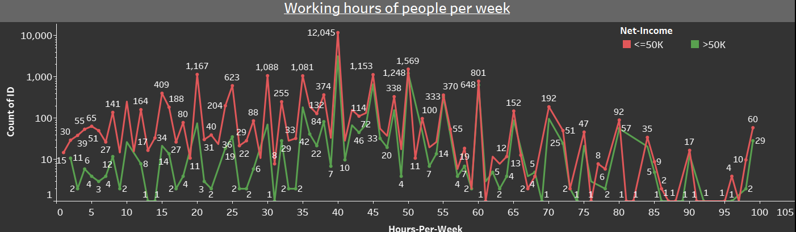
11.HOW MANY PEOPLE ARE EARNING <=50K EVENTHOUGH THEY ARE WORKING FOR A LONG TIME ?
IN THE NEXT SLIDE WE WILL SEE THE WHOLE DASHBOARD OF THE PROJECT .

Slide 6
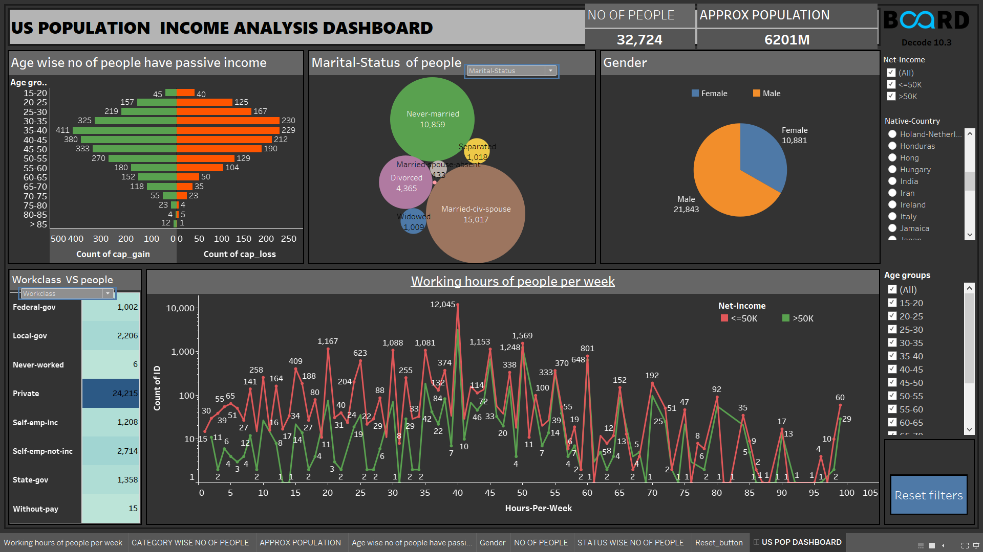

Slide 7
CONCLUSION:
ONLY VERY FEW NUMBER OF PEOPLE ARE MAKING PASSIVE INCOME WHEN COMPARED TO TOTAL POPULATION .
THE SECOND MOST RACE IN US IS BLACK .[AFTER WHITE] .
MOST NUMBER OF PEOPLE HAVE COMPLETED HS-GRAD .
INCOME IS NOT DEPENDENT ON NUMBER OF HOURS EACH INDIVIDUAL IS WORKING .
THANK -YOU
STAY SAFE

